Slide 1
Chapter - 1
Introduction to MIS &
Classification of Information Systems

Slide 2
Outline
What is MIS?
Importance of MIS?
What is e-business?
What do Managers do?
Business & Technology Trends
Re-engineering: Altering the Rules
Management and Decision Levels
An Introduction to Strategy

Slide 3
Objectives
Describe various information systems and their evolution, and categorize specific systems.
Describe and contrast transaction processing and functional information systems
Identify the major internal support systems and relate them to managerial functions.
Discuss information infrastructure and architecture.
Describe new computing environments.
Describe how information resources are managed and what are the roles of the ISD and end users

Slide 4
What is Management Information System?
  MIS is a combination of computer technology, procedures and people that is used to provide information to help making decisions and managing a firm.
  MIS is a general name for the academic discipline covering the application of people, technologies, and procedures—collectively, the information system—to business problems.

Slide 5
Information System – Primary Purpose
IS collects data, processes it into information then converts information into knowledge for a specific purpose.
Data
  Elementary description of things, events, activities, and transactions that are recorded, classified, and stored, but not organized to convey any specific meeting
Information
  Data that has been organized so that they have meaning and value to the recipient
  Data that has been put into a meaningful and useful context
Knowledge
  Information that has been organized and processed to convey understanding, experience and expertise as they apply to a current problem or activity

Slide 6
Impacts & Benefits of MIS
MIS affects all areas of business
  Manufacturing - Production
  Accounting & Finance
  Human resources
  Marketing & Sales
  Top management
Some Benefits of IS & MIS
  it can support a core competency.
  It can enhance distribution channel management.
  IS can increase production processes . IS allows a company flexibility in its output level.
  It can mean expanded E-commerce.
  Information systems force stability.
  It can improve B to B commerce

Slide 7
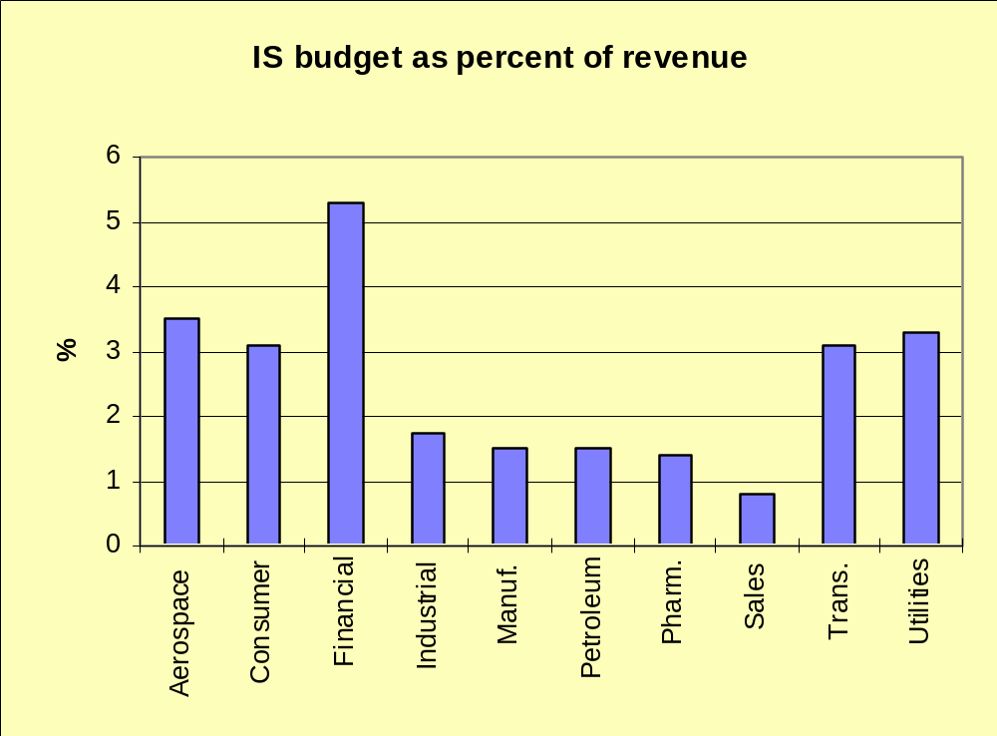
Importance of MIS
*Source : Computerworld

Slide 8
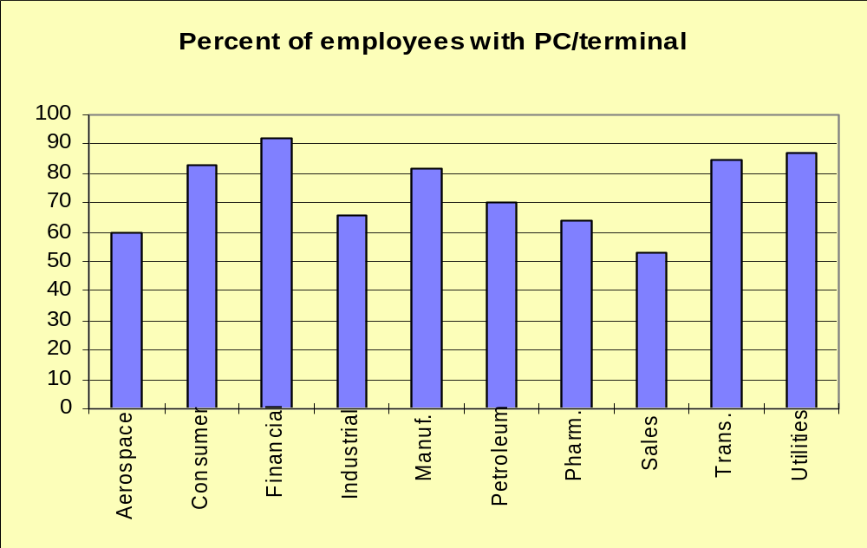
Everyone Uses Computers
*Source : Computerworld

Slide 9
What is E-Business
Business-to-Consumer (B2C)
  Selling retail products / services to consumers
Business-to-Business (B2B)
  Selling at the wholesale level to other businesses
E-Business
  Using Internet technologies to conduct any level of business
  E-Commerce
  Intranets
  Most areas of MIS

Slide 10
What do Management do?
  Organizing
  Planning
  Control
  Interpersonal relations
  Informational flow
  Budgeting
  Decisions

Slide 11
Decision Process
  Collect and Organize Data
  Put it in understandble format (information)
  Identify Problems & Opportunities
  Make operational, tactic or strategic decisions

Slide 12
Business Trends
  Changing business environment
  Specialization
  Management by Methodology and Franchises
  Mergers & Acquisitions
  Decentralization
  Temporary Workers
  Internationalization
  Service-Oriented Business
  Re-engineering
  Need for faster responses and flexibility

Slide 13
Business Trend | Implications for Technology
Specialization | Increased demand for technical skills Specialized MIS tools Increased communication
Methodology & Franchises | Reduction of middle management Increased data sharing Increased analysis by top management Computer support for rules Re-engineering
Mergers & Acquisitions | Four or five big firms dominate most industries System Integration Need for communication Strategic ties to customers and suppliers Data and system conversion
Decentralization | Communication needs Lower cost of management tasks Consolidation of data Low maintenance technology

Slide 14
Business Trend | Implications for Technology
Temporary Workers | Managing through rules Finding and evaluating workers Coordination and control Personal advancement through technology Security
Internationalization | Communication Product design System development and programming Sales and marketing
Service Orientation | Management jobs are information jobs Customer service requires better information Speed

Slide 15
Decision Levels
Decision Level | Description | Example | Type of Information
Strategic | Competitive advantage, become a market leader. Long-term outlook. | New product that will change the industry. | External events, rivals, sales, costs quality, trends.
Tactical | Improving operations without restructuring the company. | New tools to cut costs or improve efficiency. | Expenses, schedules, sales, models, forecasts.
Operations | Day-to-day actions to keep the company functioning. | Scheduling employees, ordering supplies. | Transactions, accounting, human resource management, inventory.

Slide 16
Operations, Tactics,Strategy
Function
Operations
Tactics
Strategy
Production
• Machine settings
• Rearrange work area
• New factory
• Worker schedules
• Schedule new products
• New products
• Maintenance
sch.
• Change inventory method
• New industry
Accounting
• Categorize assets
• Inventory valuation
• New GL system
• Assign expenses
• Depreciation method
• Debt vs. equity
• Produce reports
• Finance short/long term
• International taxes
Marketing
• Reward salespeople
• Determine pricing
• Monitor competitors
• Survey customers
• Promotional campaigns
• New products
• Monitor promotions
• Select marketing media
• New markets

Slide 17
Strategic Decisions & Organization
Strengths
  Source of strength
  Value of strength
  How can it be developed?
  What could undermine it?
  Development costs
  Additional benefits (opportunities)
Weaknesses
  Effect on company
  Possible solutions
  Cost of solution
  Result and cost of leaving as-is (do nothing)
  Possible prospective weakness areas

Slide 18
Information System :
An information system (IS) collects, processes, stores, analyzes, and disseminates information for a specific purpose “Application”.
IS consists of the following items :
Hardware
Software
Data
Network
Procedures
People

Slide 19
Information System –By Organization
An information system (IS) can span departments, business units and corporations.
Departmental IS
Enterprise-Wide IS
Inter-Organizational IS
Information systems are usually connected by electronic means called networks

Slide 20
Information System - By Function (Department)
An information system (IS) support each department in a corporation.
Operations
Accounting
Finance
Marketing
Human resources
Production

Slide 21
Information System - Classification By Support Function
5-year sales trend
Profit Planning
5-year budget forecasting
Product development
Executive Support System
Top Managers
Sales Management
Inventory Control
Annual budget
Production Scheduling
Cost Analysis
Pricing Analysis
Management Information System
Decision Support System
Intelligent Support System
Middle Managers
Graphics /Simulation
Software development
System support
Word Processing
Desktop Publishing
Knowledge Management System
Office Automation System
Data Workers
Order Processing
Fulfillment
Material Movement
General Ledger
Payroll
POS
Accounting
Transaction Processing System
Operational Managers

Slide 22
MIS Organization
Strategic
EIS
Mgt.
ES
Tactical
DSS
Management
Transaction
Process Control
Business Operations

Slide 23
Transaction Processing System (TPS)
TPS automates routine and repetitive tasks that are critical to the operation of the organization, such as preparing a payroll, billing customers, Point-of-Sale and Warehouse operations.
Data collected from this operation supports the MIS and DSS systems employed by Middle Management
Computerizes the primary and most of the secondary activities
Primary purpose to perform transactions and collect data.

Slide 24
Management Information Systems (MIS)
These systems access, organize, summarize, and display information for supporting routine decision making in the functional areas. Geared toward middle managers, MIS are characterized mainly by their ability to produce periodic reports such as a daily list of employees and the hours they work, or a monthly report of expenses as compared to a budget
Typical uses would be in Replenishment, Pricing Analysis and Sales Management
Decisions supported are more structured.
Primary purpose to process data into information

Slide 25
Decision Support Systems (DSS)
These systems support complex non-routine decisions.
Primary purpose to process data into information
DSS systems are typically employed by tactical level management whose decisions and what-if analysis are less structured.
This information system not only presents the results but also expands the information with alternatives.
Some DSS methodologies
  Mathematical Modeling
  Simulation
  Queries
  What-If (OLAP-Cubes)
  Data mining

Slide 26
Intelligent Support Systems (ISS)
Essentially, artificial intelligence (AI) these systems perform intelligent problem solving.
One application of AI is expert systems. Expert systems (ESs) provide the stored knowledge of experts to non-experts, so the latter can solve difficult or time-consuming problems. These advisory systems differ from TPS, which centered on data, and from MIS and DSS, which concentrated on processing information. With DSS, users make their decisions according to the information generated from the systems. With ES, the system makes recommended decisions for the users based on the built-in expertise and knowledge.

Slide 27
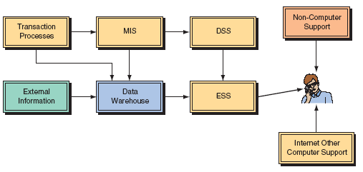
Executive Support Systems (ESS)
ESS systems or Enterprise Information Systems (EIS) originally were implemented to support Senior management. These systems have been expanded to support other managers within the enterprise.
At the senior management level they support Strategic activities which deal with situations that significantly may change the manner in which business is done.

Slide 28
Office Automation Systems (OAS)
Electronic communication is only one aspect of what is now known as an office automation system (OAS). Other aspects include word processing systems,spreadsheets, fax automation, document management systems and desktop publishing systems.
OAS systems are predominantly used by workers who support managers at all levels. Among workers, those who use, manipulate, or disseminate information are referred to as data workers.

Slide 29
Knowledge Management Systems (KMS)
An additional level of staff support now exists between top and middle management. These are professional people, such as financial and marketing analysts that act as advisors and assistants to both top and middle management. They are responsible for finding or developing new knowledge (External Content) for the organization and integrating it with existing knowledge (Internal Content).
KMS that support these knowledge workers range from Internet search engines and expert systems, to Web-based computer-aided design and sophisticated data management systems

Slide 30
Inter-Organizational Systems (IOS)
IOS are systems that connect two or more organizations. These systems are common among business partners and play a major role in e-commerce, as well as in supply chain management support.
The first type of IT system that was developed in the 1980s to improve communications with business partners was electronic data interchange (EDI), which involved computer-to-computer direct communication of standard business documents (such as purchase orders and order confirmations) between business partners. These systems became the basis for electronic markets, that later developed to electronic commerce.
Web-based systems (many using XML) deliver business applications via the Internet. Using browsers and the Internet, people in different organizations communicate, collaborate, access vast amounts of information, and run most of the organization’s tasks and processes.

Slide 31
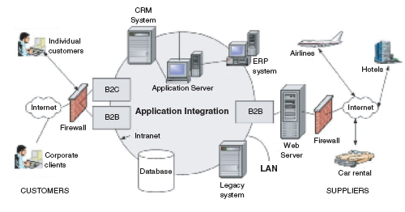
Inter-Organizational Systems (IOS)
Two or more organizations

Slide 32
Information Architecture
Classified by HW Architecture
A common way to classify information architecture is by computing paradigms, which are the core of the architecture.
Mainframe Environment
PC Environment
PC-LAN Environment
Distributed Computing Environment
Client/server Environment
Enterprise-wide Computing Environment
Legacy systems

Slide 33
The Web Based IT Architectures
Web-based systems refer to those applications or services that are resident on a server that is accessible using a Web browser. The only client-side software needed to access and execute these applications is a Web browser environment.
The Internet
Intranets
Extranets
Corporate Portals
E-commerce Systems
Electronic Storefronts
Electronic Markets
Electronic Exchanges
M-Commerce
Enterprise Web

Slide 34
The Internet
Sometimes called simply “the Net,” the Internet is a worldwide system of computer networks—a network of networks hence Internet, in which users at any one computer can get information from any other computer
The Internet uses a portion of the total resources of the currently existing public telecommunication networks. Technically, what distinguishes the Internet is its use of a set of protocols called TCP/IP (Transmission Control Protocol/Internet Protocol).

Slide 35
Intranets
An intranet is the use of Web technologies to create a private network, usually within one enterprise.
It is typically a complete LAN, or several intra-connected LANs
Intranets are used for:
  work-group activities
  the distributed sharing of projects within the enterprise
  Controlled access to company financial documents
  use of knowledge management, research materials, online training, and other information that requires distribution within the enterprise.

Slide 36
Extranets
Connect several intranets via the Internet, by adding a security mechanism and some additional functionalities
They form a larger virtual network that allows remote users (such as business partners or mobile employees) to securely connect over the Internet to the enterprise’s main intranet.
Extranets are also employed by two or more enterprises (suppliers & buyers) to share information in a controlled fashion, and therefore they play a major role in the development of business-to-business electronic commerce and Supply Chain systems.

Slide 37
Corporate Portals
Web sites that provide the gateway to corporate information from a single point of access. They aggregate information and content from many files and present it to the user.
Corporate portals also are used to personalize information for individual customers and for employees.
Intranets and Extranets are usually combined with and accessed via a corporate portal

Slide 38
E-commerce Systems
Web-based systems that enable business transactions to be conducted seamlessly twenty-four hours a day, seven days a week
Some classifications of E-commerce systems are:
  B2C (Business to Consumer)
  B2B (Business to Business)
  B2E (Business to Employee)
The major components of Web-based EC are:
  Electronic storefronts
  Electronic markets
  Mobile commerce

Slide 39
Electronic Storefronts
These are Web-equivalents of a physical store. Through the electronic storefront, an e-business can display and/or sell its products.
The storefront may include electronic catalogs that contain descriptions, graphics, and possibly product reviews.
They have following common features and functions:
  an E-catalog
  a shopping cart
  a checkout mechanism
  a payment processing feature
  a back office order fulfillment system

Slide 40
Electronic Markets
Is a web-based network of interactions and relationships over which information, products, services, and payments are exchanged. It is equivalent to a physical marketplace except is Web-based.
The principal participants in marketplaces are: transaction handlers, buyers, brokers, and sellers.
The means of interconnection vary among parties and can change from event to event, even between the same parties. Electronic markets can reside in one company, where there is either one seller and many buyers, or one buyer and many sellers. These are referred to as private marketplaces.

Slide 41
Electronic Exchanges
A special form of electronic markets electronic exchanges, are Web-based public marketplaces where many buyers and many sellers interact dynamically.
Originally set as trading places for commodities, electronic exchanges have emerged for all kinds of products and services

Slide 42
M-Commerce – Mobile Computing
M-commerce or Mobile commerce is commerce (buying and selling of goods and services) in a wireless environment, such as through wireless devices like cellular telephones and PDAs.
M-commerce enables users to access the Internet without needing to find a place to “plug” in their device.
As this wireless environment expands, a pervasive computing environment will develop, employed by mobile employees and others, will change the way business is transacted.

Slide 43
New Computing Environments
Utility Computing is computing that is as available, reliable, and secure as electricity, water services, and telephony. The vision behind utility computing is to have computing resources flow like electricity on demand from virtual utilities around the globe—always on and highly available, secure, efficiently metered, priced on a pay-as-you-use basis, dynamically scaled, self-healing, and easy to manage.
Subscription Computing is a form of utility computing that puts the pieces of a computing platform together as services, rather than as a collection of separately purchased components.
Grid Computing employs networked systems to harness the unused processing cycles of all computers in that given network thus creating powerful computing capabilities. Grid computing is already in limited use, for example the well-known grid-computing project SETI (Search for Extraterrestrial Intelligence) @Home project. In this project, PC users worldwide donate unused processor cycles to help the search for signs of extraterrestrial life by analyzing signals coming from outer space.
Pervasive Computing, a future in which computation becomes part of the environment. Computation will be embedded in things, not in computers.
Web services are self-contained, self-describing business and consumer modular applications, delivered via the Internet, that users can select and combine through almost any device, ranging from PC to mobile phones.

Slide 44
Managing Information Systems
Information Systems (IS) have enormous strategic value so when they are not working even for a short time, an organization cannot function. Furthermore, the Life Cycle Costs (acquisition, operation, security, and maintenance) of these systems is considerable. Therefore, it is essential to manage them properly. The planning, organizing, implementing, operating, and controlling of the infrastructures and the organization’s portfolio of applications must be done with great skill.
The responsibility for the management of information resources is divided between two organizational entities:
  The information systems department (ISD), which is a corporate entity
  the end users, who are scattered throughout the organization.

Slide 45
MANAGERIAL ISSUES
The transition to e-business. Converting an organization to a networked-computing-based e-business may be a complicated process. The e-business requires a client/ server architecture, an intranet, an Internet connection, and e-commerce policy and strategy, all in the face of many unknowns and risks. However, in many organizations this potentially painful conversion may be the only way to succeed or even to survive.
From legacy systems to client/server to intranets, corporate portals, and Web-based systems. A related major issue is whether and when and how to move from the legacy systems to a Web-based client/server enterprise-wide architecture. While the general trend is toward Web-based client/server, there have been several unsuccessful transformations, and many unresolved issues regarding the implementation of these systems. The introduction of intranets seems to be much easier than that of other client/server applications. Yet, moving to any new architecture requires new infrastructure and a decision about what to do with the legacy systems, which may have a considerable impact on people, quality of work, and budget.
How to deal with the outsourcing and utility computing trends.
As opportunities for outsourcing (e.g., ASPs) are becoming cheaper, available, and viable, the concept becomes more attractive. In the not-so-distant future, we will see outsourcing in the form of utility computing. How much to outsource is a major managerial issue.

Slide 46
MANAGERIAL ISSUES
How much infrastructure? Justifying information system applications is not an easy job due to the intangible benefits and the rapid changes in technologies that often make systems obsolete. Justifying infrastructure is even more difficult since many users and applications share the infrastructure that will be used for several years in the future. This makes it almost impossible to quantify the benefits. Basic architecture is a necessity, but there are some options.
The roles of the ISD and end users. The role of the ISD can be extremely important, yet top management frequently mistreats it. By constraining the ISD to technical duties, top management may risk an organization’s entire future. However, it is not economically feasible for the ISD to develop and manage all IT applications in an organization. End users play an important role in IT development and management. The end users know best what their information needs are and to what degree they are fulfilled. Properly managed end-user computing is essential for all organizations.
Ethical issues. Systems developed by the ISD and maintained by end users may introduce some ethical issues. The ISD’s major objective should be to build well-organized and helpful systems. But, such systems may attack the privacy of the users or create advantages for certain individuals at the expense of others.

